Slide 1



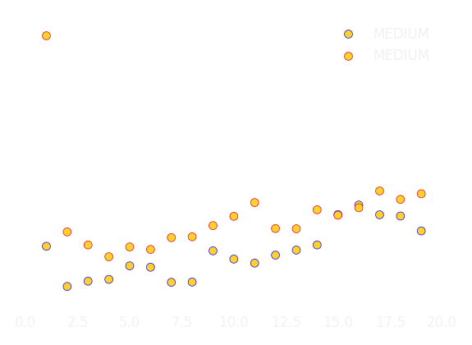

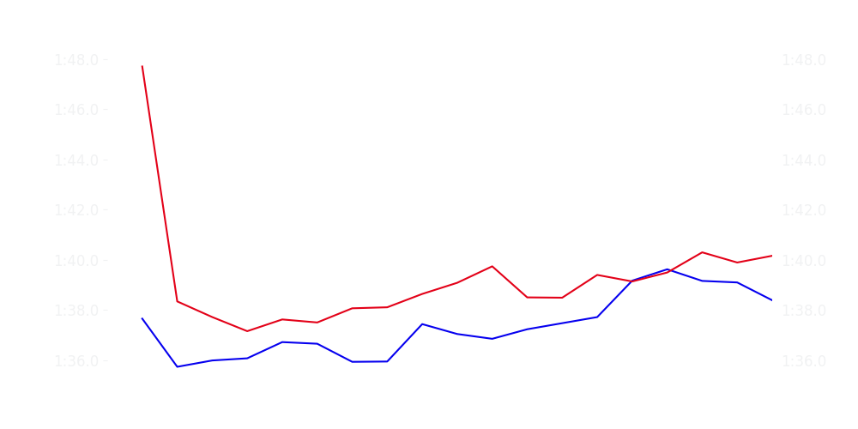
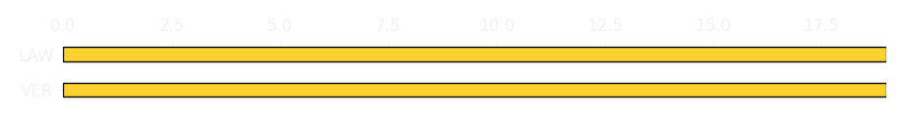
Chinese GP Sprint Race
Driver
Race Time
Race Time
Driver
Max Verstappen
0:27:36.620
0:27:59.084
Liam Lawson
Avg Lap Time
1:37.144
IQR
Gap
Gap
IQR
Avg Lap Time
1.998 s
-35.1 s
+35.1 s
1.39 s
1:38.575
Race Comparaison
Race Comparaison
Lap Advantage
17/19
Position
3
Safety Car Lap
0/19
Position
14
Lap Advantage
2/19
Lap Time Per Lap
Lap Time Per Lap
Tyre Strategy
Total Pit Stop Time
0:00:00
Pit Stops
0
Pit Stops
0
Total Pit Stop Time
0:00:00
Tyre Strategy

Slide 2

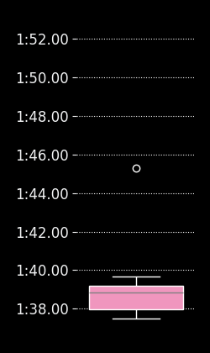
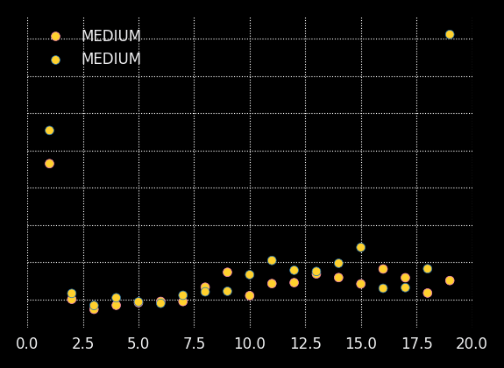
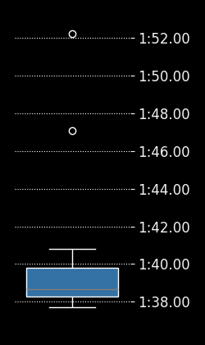
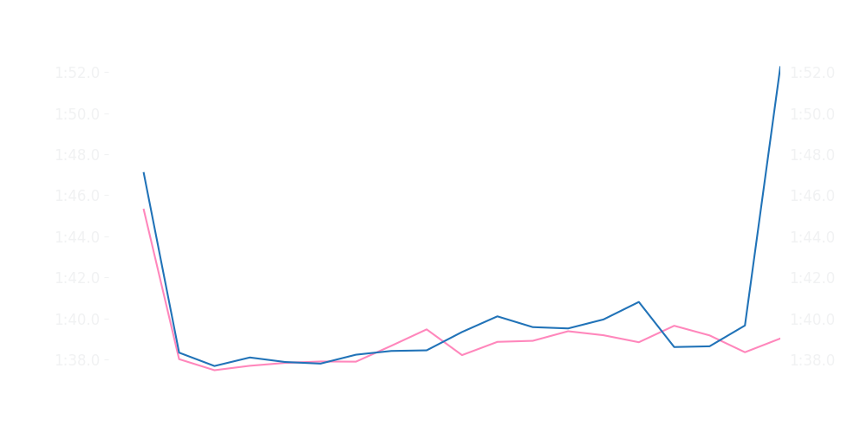

Chinese GP Sprint Race
Driver
Race Time
Race Time
Driver
Pierre Gasly
0:27:56.553
0:28:15.017
Jack Doohan
Avg Lap Time
1:38.756
IQR
Gap
Gap
IQR
Avg Lap Time
1.205 s
-20.563 s
+20.563 s
1.377 s
1:38.627
Race Comparaison
Race Comparaison
Lap Advantage
14/19
Position
12
Safety Car Lap
0/19
Position
20
Lap Advantage
5/19
Lap Time Per Lap
Lap Time Per Lap
Tyre Strategy
Total Pit Stop Time
0:00:00
Pit Stops
0
Pit Stops
0
Total Pit Stop Time
0:00:00
Tyre Strategy

Slide 3

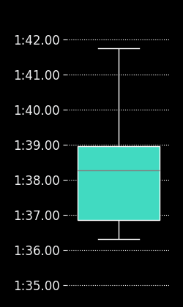
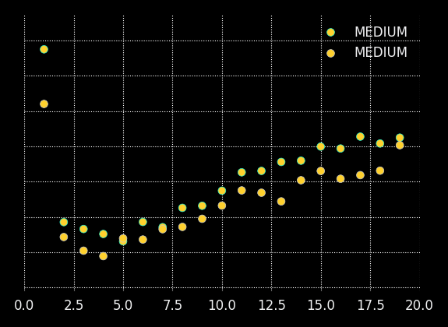
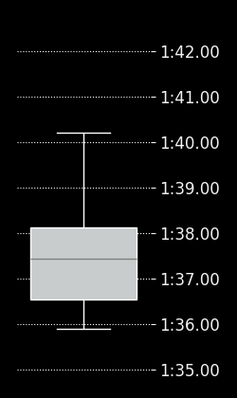
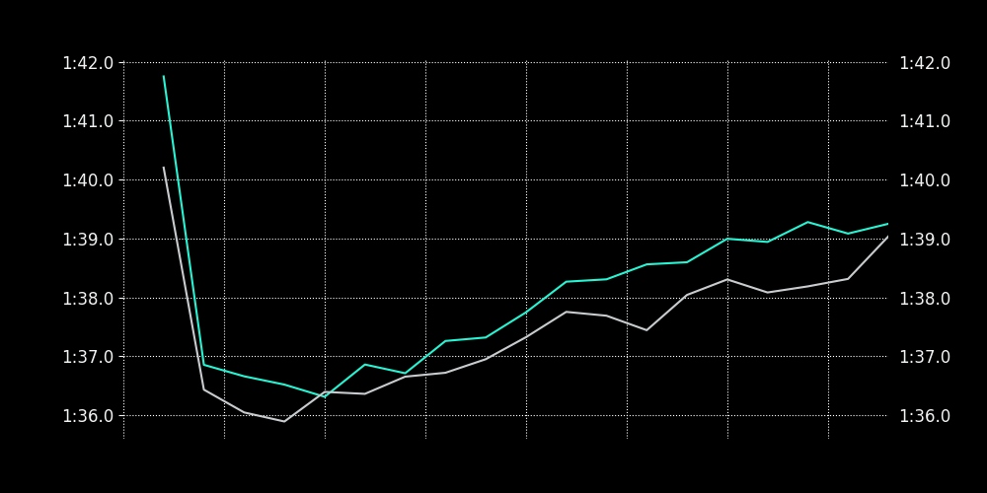

Chinese GP Sprint Race
Driver
Race Time
Race Time
Driver
Kimi Antonelli
0:27:44.654
0:27:35.179
George Russell
Avg Lap Time
1:38.005
IQR
Gap
Gap
IQR
Avg Lap Time
1.999 s
+11.446 s
-11.446 s
1.585 s
1:37.382
Race Comparaison
Race Comparaison
Lap Advantage
1/19
Position
7
Safety Car Lap
0/19
Position
4
Lap Advantage
18/19
Lap Time Per Lap
Lap Time Per Lap
Tyre Strategy
Total Pit Stop Time
0:00:00
Pit Stops
0
Pit Stops
0
Total Pit Stop Time
0:00:00
Tyre Strategy

Slide 4


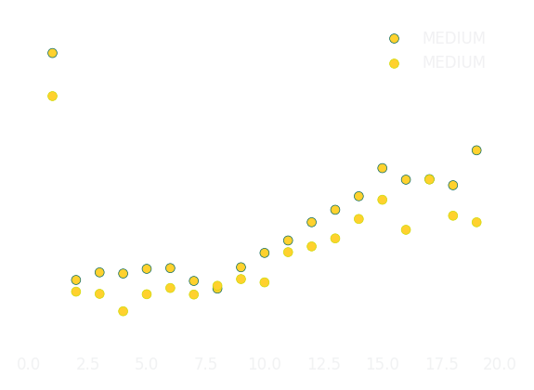

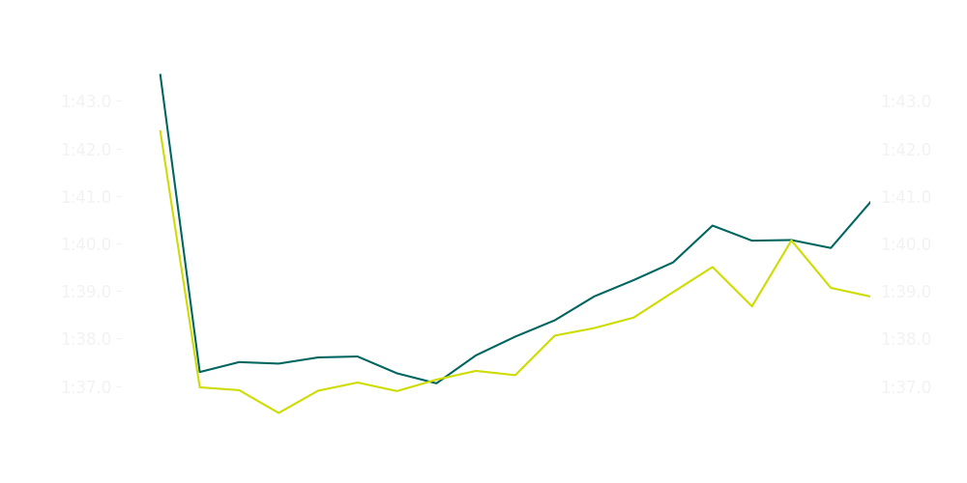

Chinese GP Sprint Race
Driver
Race Time
Race Time
Driver
Fernando Alonso
0:27:57.598
0:27:45.804
Lance Stroll
Avg Lap Time
1:38.212
IQR
Gap
Gap
IQR
Avg Lap Time
2.3 s
+13.302 s
-13.302 s
1.834 s
1:37.691
Race Comparaison
Race Comparaison
Lap Advantage
1/19
Position
10
Safety Car Lap
0/19
Position
9
Lap Advantage
18/19
Lap Time Per Lap
Lap Time Per Lap
Tyre Strategy
Total Pit Stop Time
0:00:00
Pit Stops
0
Pit Stops
0
Total Pit Stop Time
0:00:00
Tyre Strategy

Slide 5

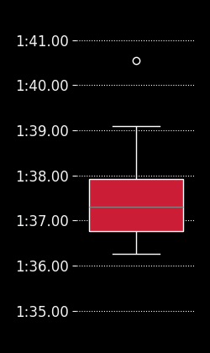
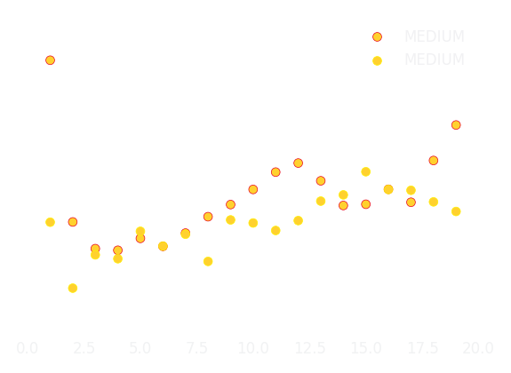
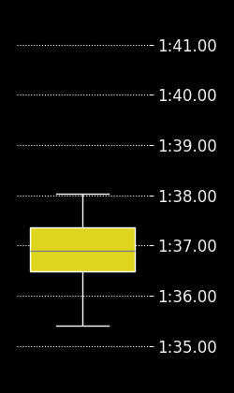
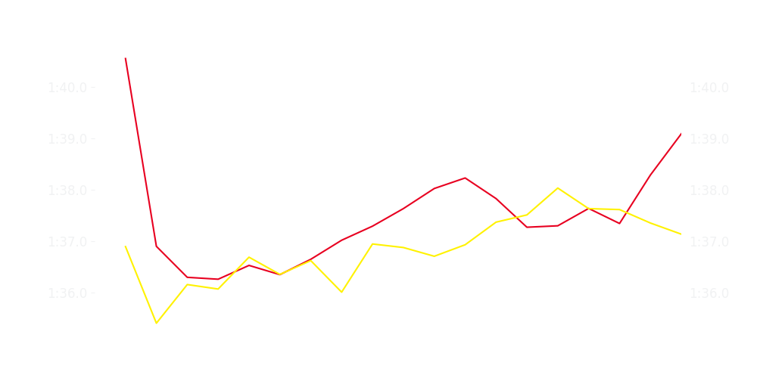

Chinese GP Sprint Race
Driver
Race Time
Race Time
Driver
Charles Leclerc
0:27:34.967
0:27:27.933
Lewis Hamilton
Avg Lap Time
1:37.291
IQR
Gap
Gap
IQR
Avg Lap Time
1.071 s
+12.190 s
-12.190 s
0.946 s
1:36.899
Race Comparaison
Race Comparaison
Lap Advantage
5/19
Position
5
Safety Car Lap
0/19
Position
1
Lap Advantage
14/19
Lap Time Per Lap
Lap Time Per Lap
Tyre Strategy
Total Pit Stop Time
0:00:00
Pit Stops
0
Pit Stops
0
Total Pit Stop Time
0:00:00
Tyre Strategy

Slide 6


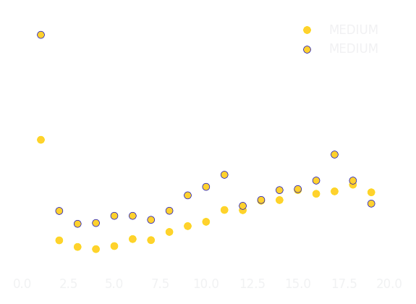

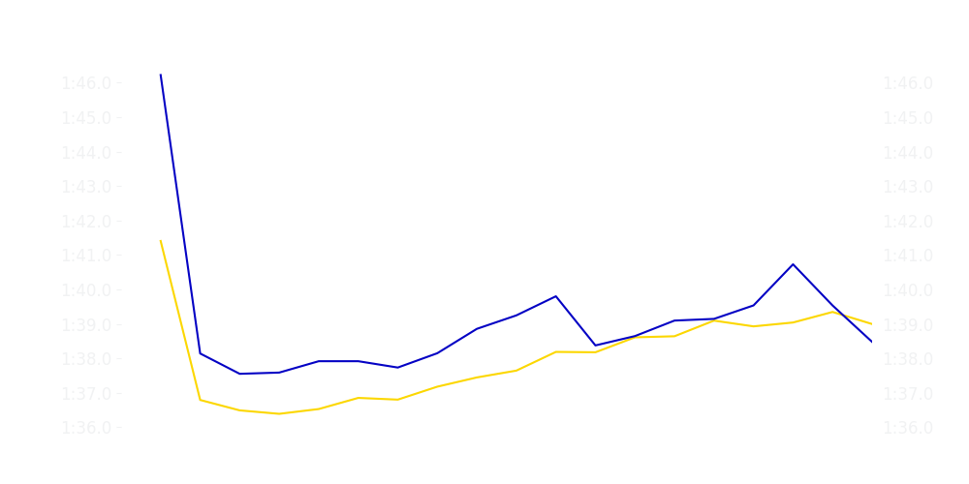

Chinese GP Sprint Race
Driver
Race Time
Race Time
Driver
Yuki Tsunoda
0:27:44.316
0:27:58.263
Isack Hadjar
Avg Lap Time
1:37.908
IQR
Gap
Gap
IQR
Avg Lap Time
2.042 s
-20.112 s
+20.112 s
1.249 s
1:38.560
Race Comparaison
Race Comparaison
Lap Advantage
18/19
Position
6
Safety Car Lap
0/19
Position
13
Lap Advantage
1/19
Lap Time Per Lap
Lap Time Per Lap
Tyre Strategy
Total Pit Stop Time
0:00:00
Pit Stops
0
Pit Stops
0
Total Pit Stop Time
0:00:00
Tyre Strategy

Slide 7

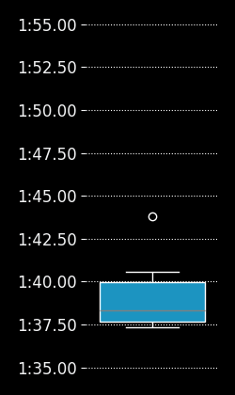
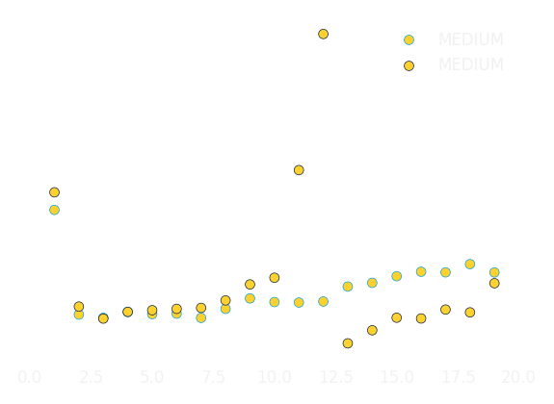

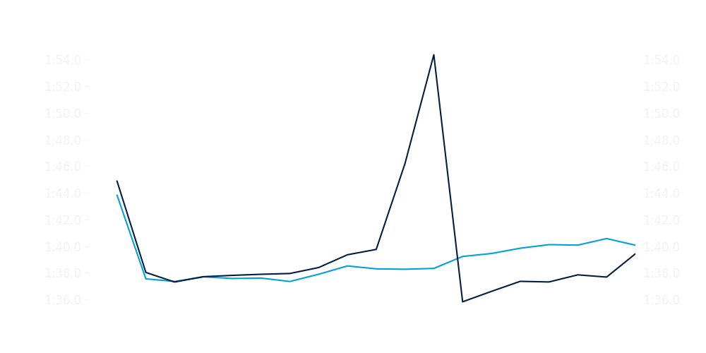
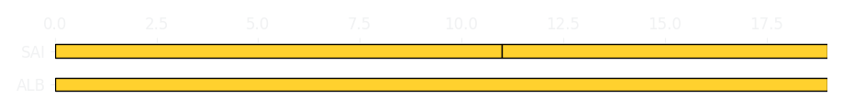
Chinese GP Sprint Race
Driver
Race Time
Race Time
Driver
Alexander Albon
0:27:58.156
0:28:08.708
Carlos Sainz
Avg Lap Time
1:38.309
IQR
Gap
Gap
IQR
Avg Lap Time
2.118 s
-12.084 s
+12.084 s
1.674 s
1:37.863
Race Comparaison
Race Comparaison
Lap Advantage
11/19
Position
11
Safety Car Lap
0/19
Position
17
Lap Advantage
8/19
Lap Time Per Lap
Lap Time Per Lap
Tyre Strategy
Total Pit Stop Time
0:00:00
Pit Stops
0
Pit Stops
0
Total Pit Stop Time
0:00:00
Tyre Strategy

Slide 8

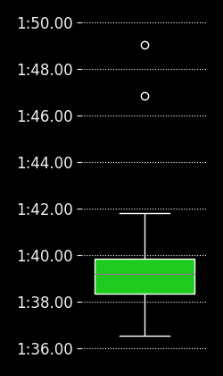
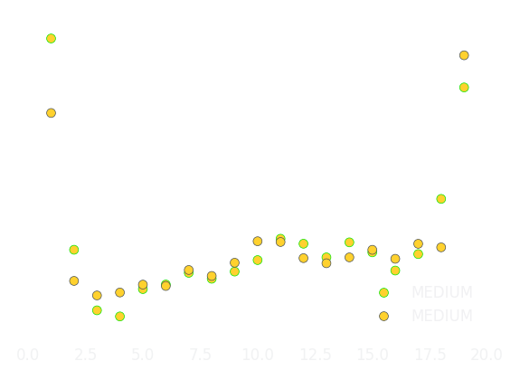

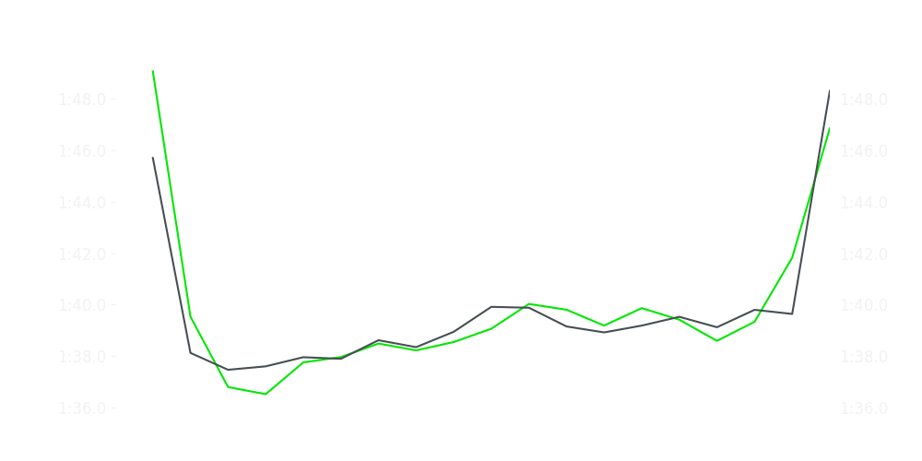

Chinese GP Sprint Race
Driver
Race Time
Race Time
Driver
Nico Hulkenberg
0:28:08.319
0:28:10.337
Gabriel Bortoleto
Avg Lap Time
1:39.129
IQR
Gap
Gap
IQR
Avg Lap Time
1.443 s
+02.742 s
-02.742 s
1.428 s
1:39.037
Race Comparaison
Race Comparaison
Lap Advantage
11/19
Position
19
Safety Car Lap
0/19
Position
18
Lap Advantage
8/19
Lap Time Per Lap
Lap Time Per Lap
Tyre Strategy
Total Pit Stop Time
0:00:00
Pit Stops
0
Pit Stops
0
Total Pit Stop Time
0:00:00
Tyre Strategy

Slide 9


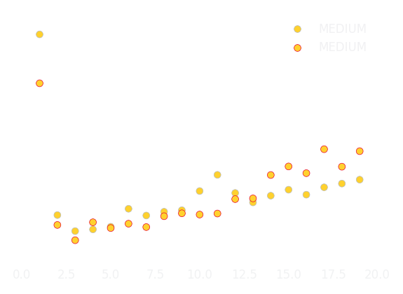

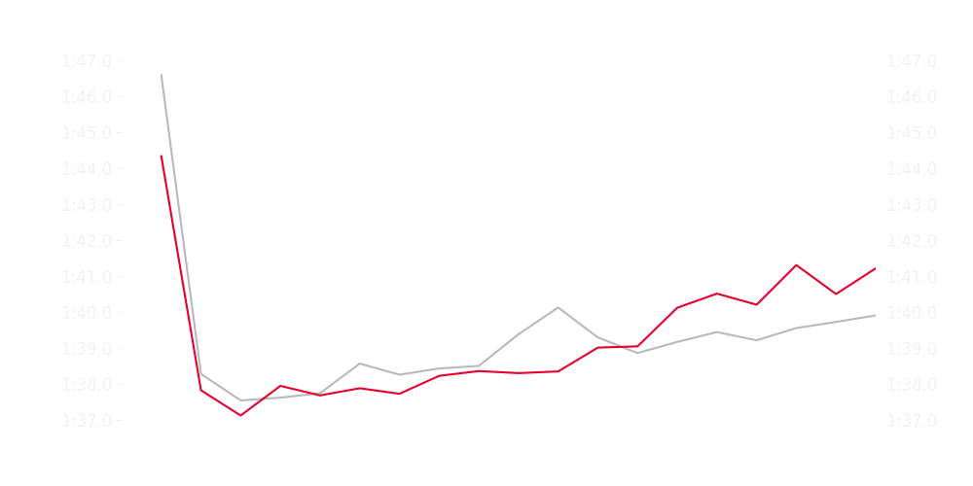

Chinese GP Sprint Race
Driver
Race Time
Race Time
Driver
Esteban Ocon
0:28:01.527
0:28:03.694
Ollie Bearman
Avg Lap Time
1:39.025
IQR
Gap
Gap
IQR
Avg Lap Time
1.111 s
+00.533 s
-00.533 s
2.283 s
1:38.365
Race Comparaison
Race Comparaison
Lap Advantage
8/19
Position
16
Safety Car Lap
0/19
Position
15
Lap Advantage
11/19
Lap Time Per Lap
Lap Time Per Lap
Tyre Strategy
Total Pit Stop Time
0:00:00
Pit Stops
0
Pit Stops
0
Total Pit Stop Time
0:00:00
Tyre Strategy

Slide 10

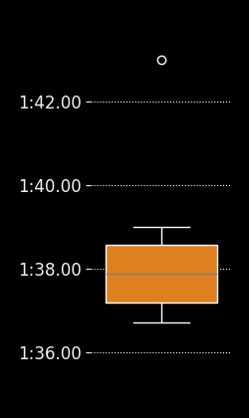
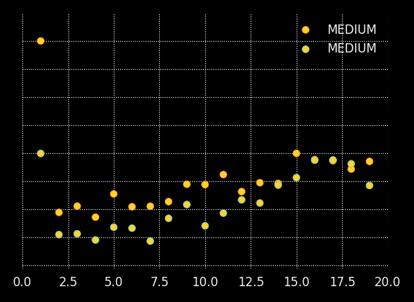

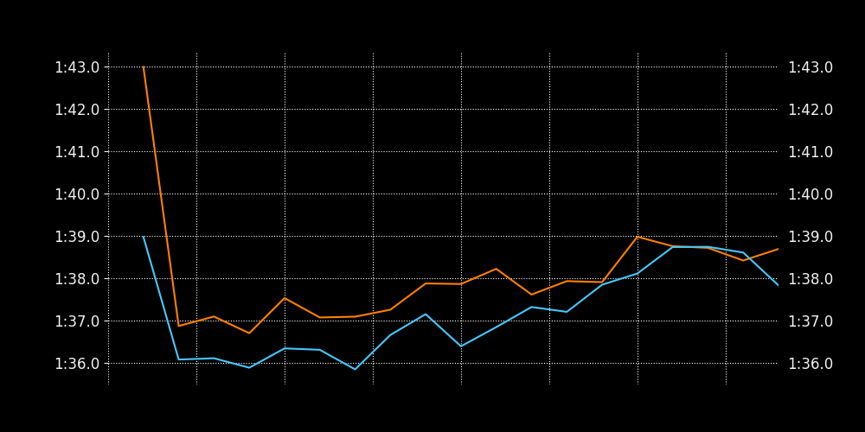

Chinese GP Sprint Race
Driver
Race Time
Race Time
Driver
Lando Norris
0:27:43.822
0:27:32.045
Oscar Piastri
Avg Lap Time
1:37.875
IQR
Gap
Gap
IQR
Avg Lap Time
1.234 s
+16.582 s
-16.582 s
1.524 s
1:37.004
Race Comparaison
Race Comparaison
Lap Advantage
2/19
Position
8
Safety Car Lap
0/19
Position
2
Lap Advantage
17/19
Lap Time Per Lap
Lap Time Per Lap
Tyre Strategy
Total Pit Stop Time
0:00:00
Pit Stops
0
Pit Stops
0
Total Pit Stop Time
0:00:00
Tyre Strategy

